Slide 1

Notes:
Session flow

Slide 2

CENTRUM GROUP
CORPORATE PROFILE

Slide 3

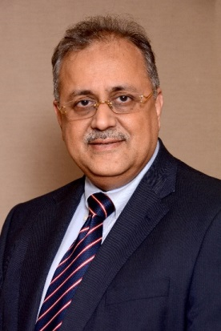
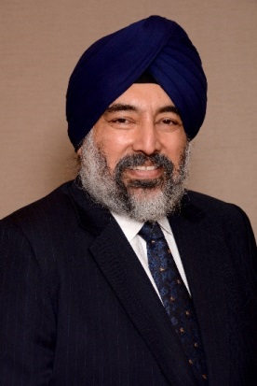
Promoters
Chandir Gidwani
Founder & Chairman Emeritus
Jaspal Bindra
Executive Chairman
A distinguished first generation entrepreneur
As the Founder of the company, he has set up a robust platform that offers integrated financial services for Institutions as well as Individuals.
He has contributed greatly to building a strong reputation and goodwill for the Group and built a highly experienced and competent management team, which is poised to lead Centrum into a high growth trajectory.
An astute investor with a vision of identifying businesses that have immense growth potential
A qualified Chartered Accountant.
A seasoned Banker with a successful global MNC career of 30 years.
Was previously the Asia-Pacific Head of Standard Chartered Bank and has also worked with Bank of America & UBS.
Has vast expertise in all areas of banking including Treasury, Capital markets, Investment Banking and Consumer Banking.
A qualified Chartered Accountant and MBA from XLRI, Jamshedpur.
Notes:
Session flow

Slide 4


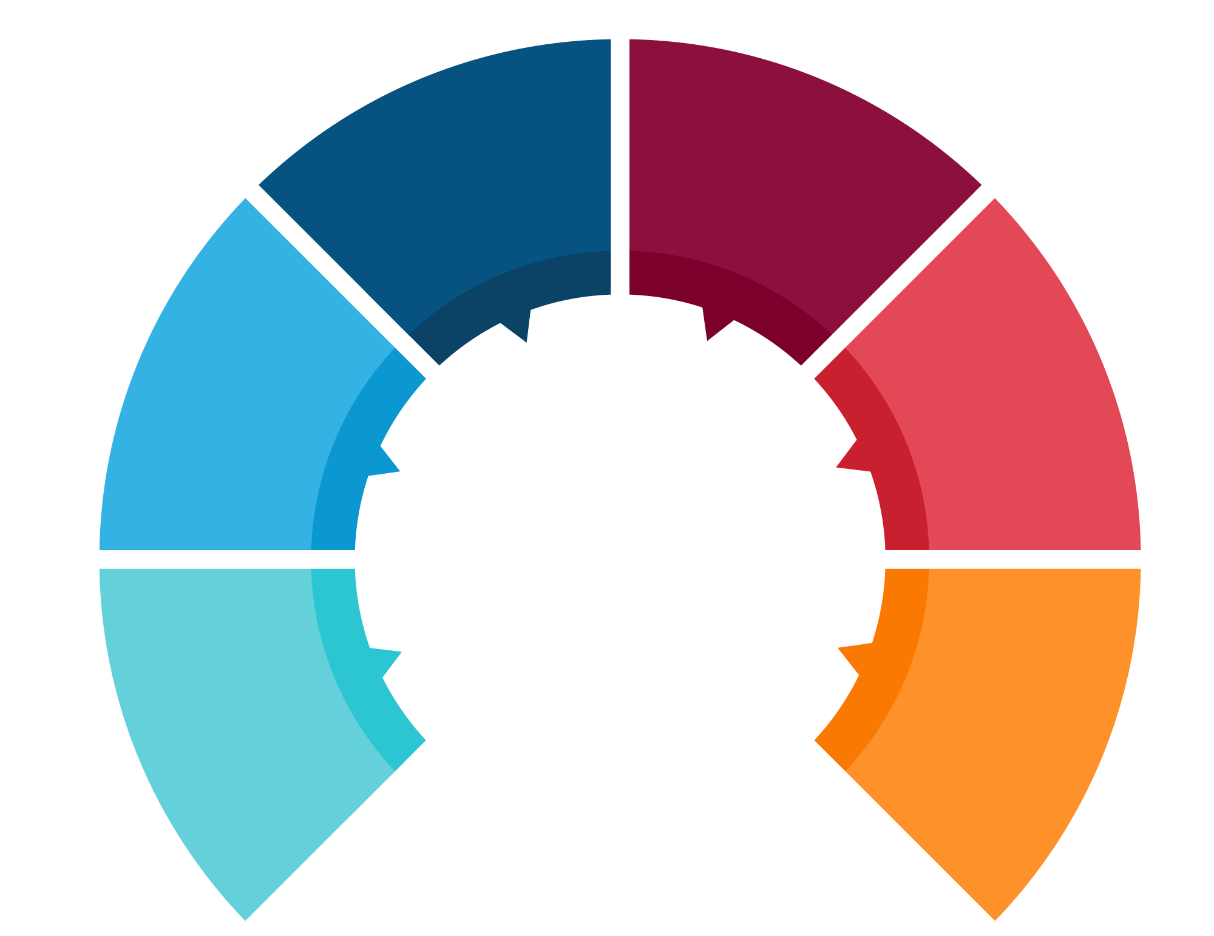

About Centrum Group
Retail services include - Integrated solutions for Private Wealth Management, Money Exchange, Housing Finance and Insurance Distribution
Expanded its focus from a fee based business model to a fee cum lending model in 2016.
Institutional Services include – Investment Banking,
Stock Broking, SME Finance and Corporate Treasury Solutions.
A dedicated Investment Management Division offering services in Public Equity, Private Equity & Real Estate
An integrated domestic financial services conglomerate
with over two decades of experience in the financial markets across various cycles
Present in 48 cities
across India
with a strength of 2000+ employees. Listed on the Bombay Stock Exchange
Notes:
Session flow

Slide 5





Company Structure
Centrum Group
Institutional
Services
Individual
Services
Investment
Management
Investment Banking
Money Exchange
Public Equity
Institutional Broking
Wealth Management
Private Equity
Business Loans
Housing Finance
Credit
Corporate Treasury
Insurance
Real Estate
Notes:
Session flow

Slide 6


Key Milestones
1997
Commenced operations as a Money changer and Merchant Banker
2001
2006
Commenced our Project Finance business.
Started our Institutional Broking business.
2010
2011
JV with CFC, Hong Kong to offer Asset Management Services
Set up a Wealth Management vertical to offer Investment Advisory, Portfolio Management and Family Office Services
2015
Launched www.centrumforex.com an online portal to Exchange Currency
2016
Launched our maiden PE fund – Kalpavriksh. Launched Centrum Pay – An innovative Mobile wallet backed by a physical card
Commenced operations in Insurance Distribution, Housing Finance, SME Finance
2017
Received a Direct Insurance Broking License
Acquired MFI portfolio of FirstRand Bank, India
Notes:
Session flow

Slide 7





Investment Banking
Equity Capital Markets
Debt Capital Markets
Corporate Finance
Infrastructure & Defence
IPOs, FPOs, QIPs, Company Valuations, Buybacks, ADRs & GDRs,
Working Capital, Trade Finance, Bill Discounting, Corporate Loans, Project Finance, Foreign Currency Loans, Stressed Asset Resolution
Capital Structuring Leverage,
Re-Financing & Mezzanine Financing, M&A, Liquidity Management
Infrastructure: M&A, Private Equity, Bid Advisory, Structured Funding, Insolvency & Bankruptcy resolution.
Defence: Entry Strategy, JV / Partnerships
Rajendra Naik
MD – Investment Banking
Total Experience – 20 yrs
Previous assignment – Apple Finance
Joined Centrum in 1997
MMS – Mumbai University
K. R. Menon
ED – Debt Syndication
Total Experience – 30 yrs
Previous assignment - Wachovia Bank
Joined Centrum in 2007
LLB – Mumbai University
Sandeep Upadhyay
MD & CEO – Infrastructure Advisory
Total Experience – 15 yrs
Previous assignments – IL&FS & SBI Capital
Joined Centrum in 2008
MBA - XLRI.
Highlights:
Centrum has raised over INR 2 trillion of Capital for the industry.
Marquee Projects include - Bandra Worli Sea Link & Mumbai Pune express way.
Only Investment Bank in India with an expert team for Infrastructure & Defence.
Notes:
Session flow

Slide 8

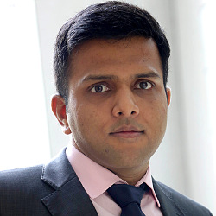
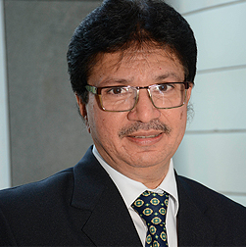
Stock Broking
A full service brokerage house offering services to Institutional and Non-Institutional investors. It offers advisory and execution platforms for Equities and Derivatives.
Institutional Equities
Institutional Research
Investor Conferences
Private Client Services
Specialisation in midcap research segment, primary equity offerings, including IPOs/QIPs, catering specifically to domestic institutional investors.
Niche Midcap ideas
12 Sectors under coverage
Theme based research initiatives
Centrum Corporate Connect
Feet on the Street
1st ever Steel Symposium
Portfolio Diagnosis
Continuous Review
Interaction & Collaborated process
Gaurav Bhandari
MD – Institutional Equities (Sales)
Total Experience – 17 yrs
Previous assignment – ICICI Securities
Joined Centrum in 2009
Executive MBA – IIM Calcutta
Paresh Shah
MD – Institutional Equities
(Sales Trading)
Total Experience – 25 yrs
Previous assignment – IDFC Securities
Joined Centrum in 2013
Chartered Accountant
Highlights:
Our path-breaking research on midcap stocks has received several accolades from institutional investors.
Our ideas have been highlighted on several occasions in HDFC MF's 'Annual Top Ideas‘
Our analysts are mentioned regularly in polls conducted by institutional investors and Asiamoney.
Notes:
Session flow

Slide 9

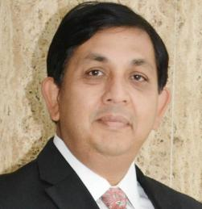
Business Loans
Providing Business Loans in Metro & Tier 2 Cities
Credit Solutions for Emerging Corporates
Supply Chain Solutions
Micro Finance
Structured Credit Solutions
Working Capital Solutions
Promoter Financing
Real Estate Finance
Lending to Microfinance / MSME sectors.
Dealer Finance
Receivables Discounting Finance
Receivable Finance solutions
Joint liability group (JLG) mode
Underserved & Unserved customers in semi urban areas
Borrowers operating small businesses
Ranjan Ghosh
MD & CEO – NBFC
Total Experience – 26 yrs
Previous assignments – Standard Chartered & HSBC
Joined Centrum in 2016
MBA - The University of Northern Iowa
Highlights:
Commenced operations in 2017. Currently have a team of 30 professionals, in Mumbai, Delhi, Kolkata, Ahmedabad, & Baroda
We aim to reach an asset book of Rs. 7000 crores by 2022.
Acquired MFI business of FirstRand Bank, India
Notes:
Session flow

Slide 10

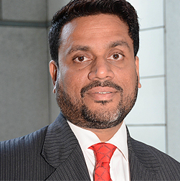
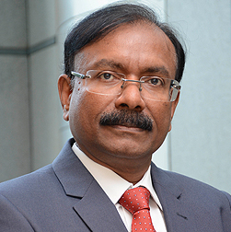
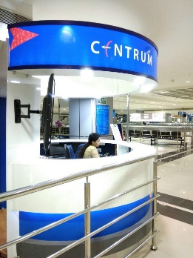
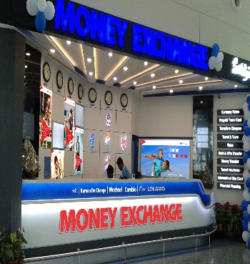
Money Exchange
India's leading Money Exchange Company with an extensive branch network spanning 46 Cities and 19 International Airports.
Currency Notes
Travelers Cheque
International Money Transfer
Forex Card
Centrum Pay
Centrum purchases and sells more than 41 different tradeable currencies and is one of the largest Importers of Currency notes in India.
One the oldest and largest partner to American Express for distribution of Travelers Cheques.
Outward & Inward remittance facilities in 19 different currencies
One of the largest issuer of Multi Currency Cards. The Centrum Multi Currency card has 17 Currency wallets.
Centrum Pay wallet is a first of its kind mobile wallet application backed by a virtual and a physical card.
T. C. Guruprasad
MD & CEO
Total Experience – 20 yrs
Previous assignment – LKP Merchant Financing
Joined Centrum in 1998
MBA - NIBM
Kumud Mohanty
Joint MD & COO
Total Experience – 30 yrs
Previous assignments – Bank of India
Joined Centrum in 2010
M.Sc - Physics
Highlights:
Centrumforex.com is the biggest Online forex platform
providing door step delivery & 24*7 customer care
Strategic investments by Jacob Ballas, New York Life & Evolvence
Biggest Money Exchange company in Overseas Education related Money
Transfer and Forex Product Issuances.
Notes:
Session flow

Slide 11




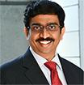
Wealth Management
Specializes in creating customized innovative solutions for wealth creation and preservation.
Advisory Services
Wealth Research
Family Office
Portfolio Management Services
Mutual Funds
Real Estate
Structured Products
Alternate Assets
Risk Management
Equity & Bonds
Fixed Income & Debts
Niche Ideas in the Mid Cap Space
Theme based Research
Philanthropy
Investment Planning
Tax & Financial Planning
Family Legacy & Leadership
Trust & Estate Services
Concentrated portfolio of 15-20 stocks
Aimed at maximizing returns
Different portfolios for different risk appetites
Rajnish Bahl
MD & CEO, Group Retail Financial Services
Total Experience – 29 yrs
Previous assignments – HSBC, SCB, Citibank & ANZ Grindlays
Joined Centrum in 2010
Chartered Accountant - Gold Medal in Auditing
S. Ganashyam
ED – Wealth Management
Total Experience – 23 yrs
Previous assignments – HSBC, ABN AMRO & Anand Rathi
Joined Centrum in 2010
MBA - Mumbai University & CFA
Arpita Vinay
Wholetime Director
& Head – Family Office
Total Experience – 17 yrs
Previous assignments – HSBC & TATA Steel
Joined Centrum in 2010
MBA - FMS, Delhi
Sandeep Nayak
ED & CEO – Broking
Total Experience – 23 yrs
Previous assignments – HSBC & Kotak Securities
Joined Centrum in 2011
CA & ICWA (All-India first Rank & Gold Medallist)
Highlights:
Voted as the Best Domestic Private Bank in India by Asiamoney – 2016
Rated as having the Best Fundamental Equity Research Platform by Zee Business
Notes:
Session flow

Slide 12


Insurance
An Insurance Broker empanelled to offer Products & Services of Insurance companies in India
Life Insurance
General Insurance
Health Insurance
Travel Insurance
Term Insurance
Child Plans
Unit Link Insurance Plans
Retirement Plans
Cancer Care Plans
Car Insurance
Two Wheeler Insurance
Home Insurance
Disability Insurance
SME & Corporate Insurance
Family Floater Plans
Top Ups
Senior Citizen Plans
Diabetic Care
Individual Travel
Student Travel
Anirudh Jain
Head – Insurance
Total Experience – 15 yrs
Previous assignments – Destimoney, Indiabulls & HDFC
Joined Centrum in 2015
MBA from
Highlights:
One of the Companies to offer services in Corporate, HNI and Retail Segments.
Sold 10,000 policies in 1st year of operations. Now scaled up by selling 5000 policies every month in its 2nd year of business operations.
Notes:
Session flow

Slide 13

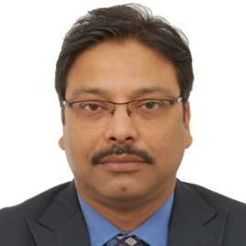
Housing Finance
Providing Housing Finance Solutions in Tier 2 & 3 cities in India. Currently present in Madhya Pradesh, Gujarat, Chhattisgarh and Maharashtra
Home Loans
Loan Against Property
Renovation Loans
Plot + Construction Loans
Sanjay Shukla
MD & CEO – Housing Finance
Total Experience – 27 yrs
Previous assignments – Centbank Home Finance, ING Vysya, TATA Capital, Citibank & LIC Housing
Joined Centrum in 2016
Chartered Accountant
Highlights:
Vision to become a well-run HFC addressing underserved ‘affordable’ segments with AUM of over INR 5,000 crores by 2022.
Currently focused on Central & Western India with a plan to expand to other geographies.
One of the fastest companies to reach a portfolio of INR 50 crores within 6 months of launch.
Notes:
Session flow

Slide 14

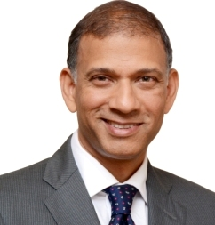
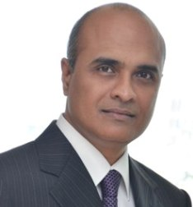
Investment Management
A broad spectrum of alternative investments – public equity, private equity, credit and real estate
Public Equity
Private Equity
Credit
Real Estate
Long Only
Long / Short
Quant
Venture growth focused on consumer sector
Special Situations Credit Fund
Debt + Equity Projects
Shujaat Khan
MD & Head –
Investment Management
Total Experience – 17 yrs
Previous assignments – Orios Venture Partners, Blue River Capital & ChrysCapital
Joined Centrum in 2017
MBA - Harvard Business School
Giri Krishnaswamy
CIO – ACORN Fund
Total Experience – 25 yrs
Previous assignments – Indi trade Capital, Destimoney Securities & Nestle
Joined Centrum in 2016
CPA - Colorado Board, USA
Highlights:
Team of 30 investment and asset management professionals growing to approximately 50 in the next 12 months
Managing assets for domestic and international investors

Slide 15
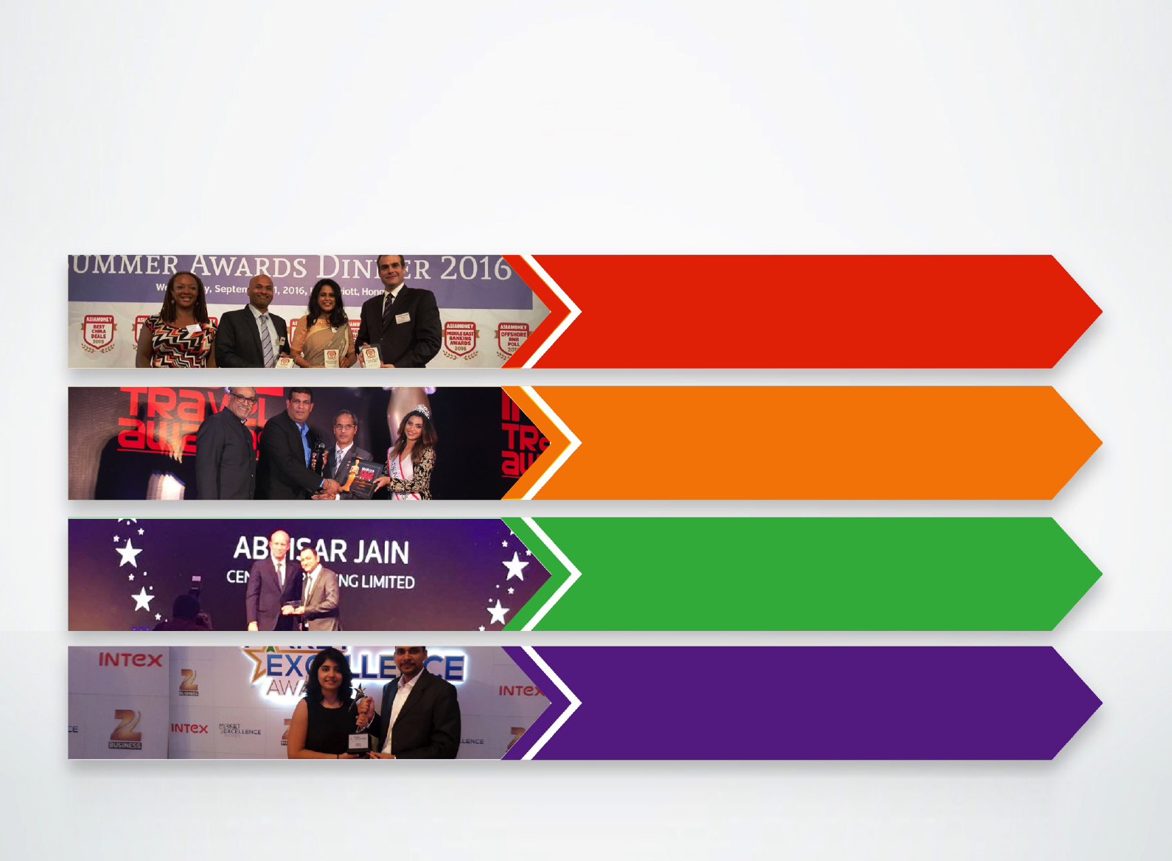

Rewards & Recognitions
Voted as the Best Domestic Private
Bank in India 2016 by Asiamoney
Voted as the ‘Best Foreign Exchange
Company’ for 3 consecutive years at the
India Travel Awards 2014-16
Best Analyst – Industry Earnings
Estimator 2017 - Metals & Mining Sector
by Thomson Reuters
Best Banking Analyst – Zee Business’s
“India’s Best Market Analyst
Award 2016” Industry Earnings
Notes:
Session flow

Slide 16


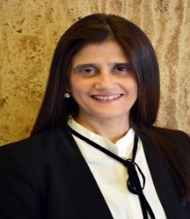
Life at Centrum
We Recruit for - Domain Expertise, Passion, Attitude, Commitment and Diversity
Entrepreneurship - It runs through the DNA of every Centrumite
What we offer – Focus on Talent Development, Work Life Balance, Career Progression
Building Managerial Leadership Capabilities & Strong Value based Culture
Deepa Poncha
Director – Human Resources
Total Experience – 22 yrs
Previous assignments – P&O Nedlloyd & TATA Housing
Joined Centrum in 2007
MBA from Mumbai University
Highlights:
We reward on merit and performance, which is why many members of our senior management team are as young as 35 years.
Notes:
Session flow

Slide 17


Life at Centrum
Training & Development
- Aptitude & Behavioural trainings
- External training sessions at management institutes
Employee Engagement
- Healthy work life balance
- Fun filled activities round the year
- Annual Cricket Tournament, Indoor Sports, Yoga Sessions
and a fully equipped gym
- Food festivals
- Medical Check-up camps
Campus Connect
- Management Trainee Programme
- Alliances with XLRI, FMS, NMIMS, JBIMS etc.
- On the Job Training
Centrum Foundation
- Creating awareness for water conservation
- Blood donation camps
- Associated with an old age home in Pune to help build infrastructure and provide medical support
Notes:
Session flow

Slide 18

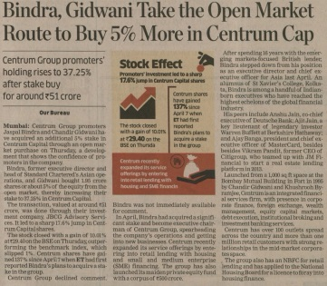
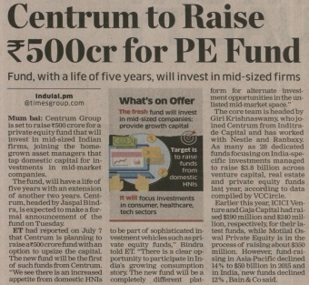
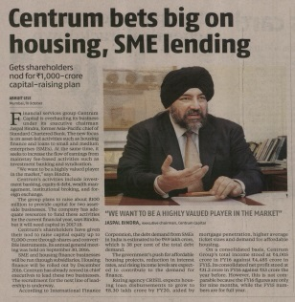
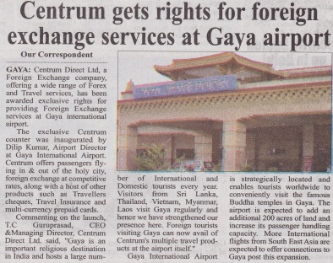
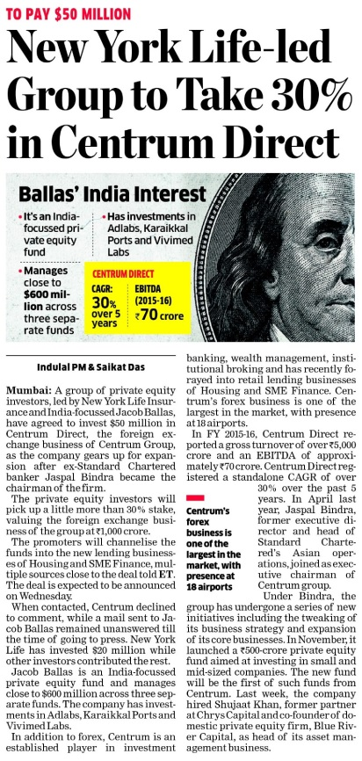
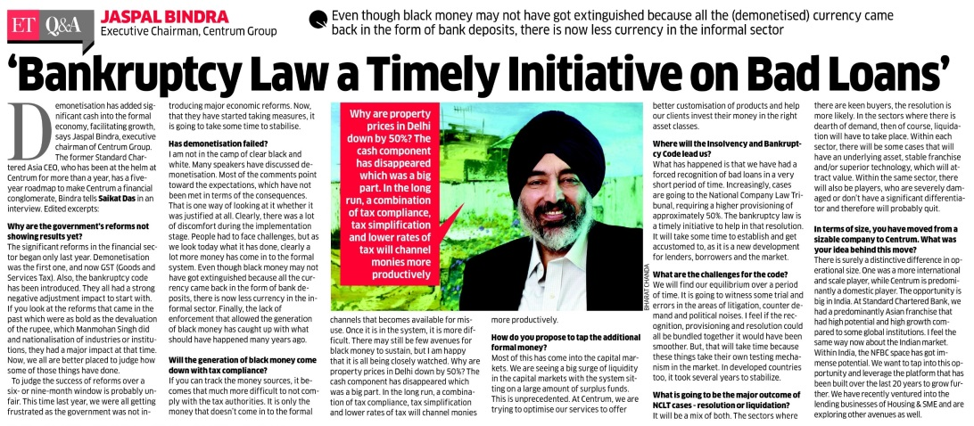
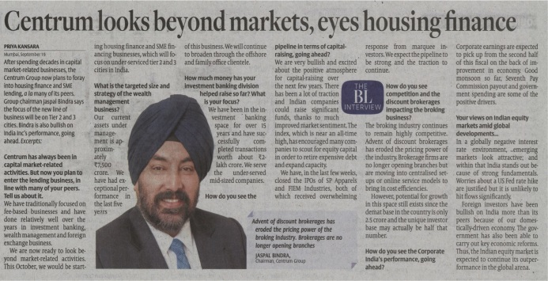
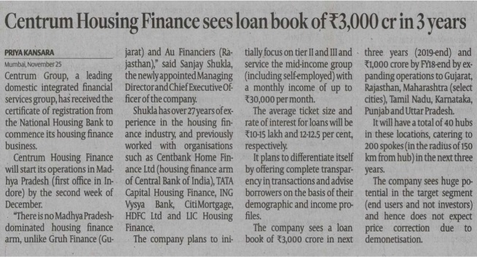
Press Release
Notes:
Session flow

Slide 19

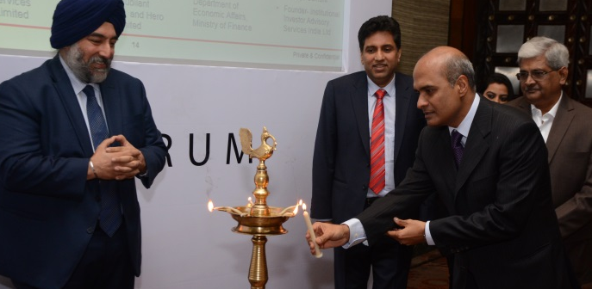
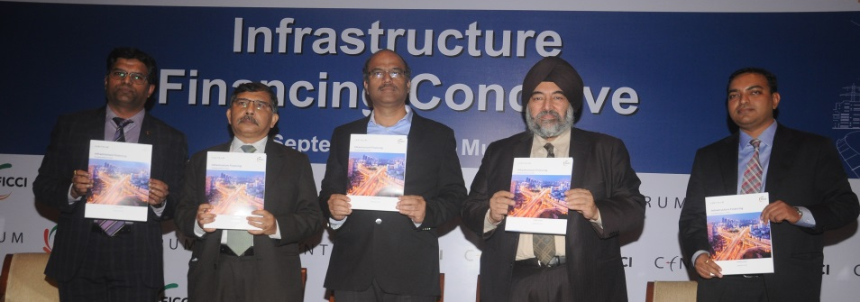
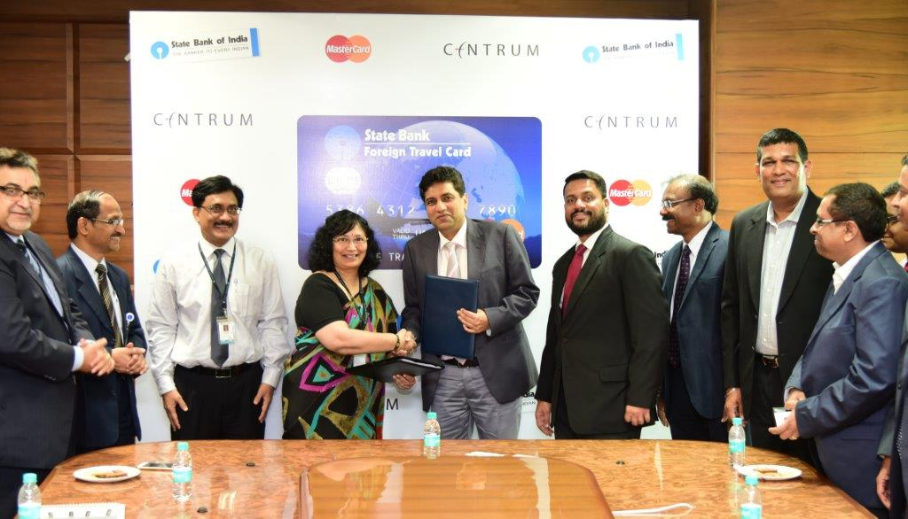
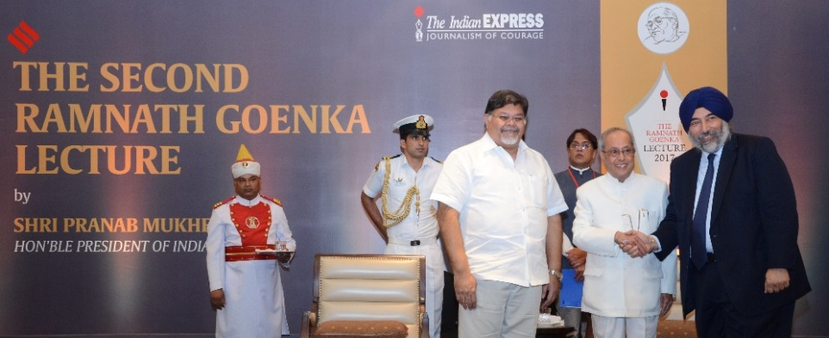
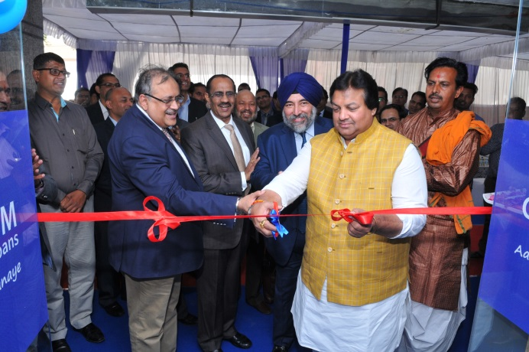
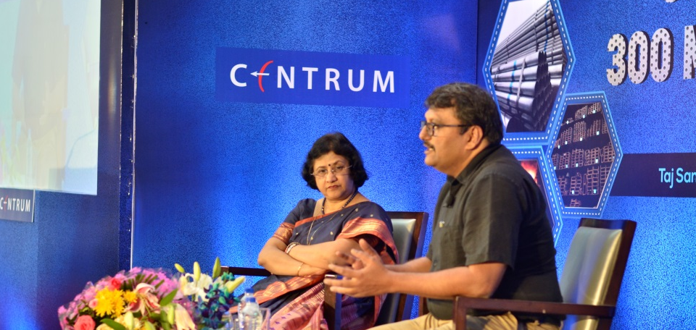
Events
Notes:
Session flow

Slide 20
THANK YOU
Notes:
Session flow

