Slide 1
NRI Press.com
NRIpress.com Inc.

Slide 2
Introduction
For the past 10 years NRIInternet.com (under the umbrella of Globex Tech Inc.) has been running a non-stop operation of NRI News.
In 2004, NRIPress.com Inc was registered as an internet domain.
In 2007, after an overwhelming response from our sponsors, readers, founders and drawn by technology trends of electronic media, Globex Tech’s management decided to set up an all new corporation for this great opportunity to run and expand the current business model worldwide and in an efficient way so it reaches our NRI community.
After the incorporation, common stocks were issues worldwide.
In 2009, operation of NRI news through Independent web site and its worldwide expansion started.
Our mega project of incorporating multiple NRI domain names such as NRIRealtors.com has been a great success.

Slide 3
Worldwide Expansion

Slide 4
Each country will be linked to major city/state
For e.g. NRIPress.com/USA will be further linked to New York, Chicago, California etc. Each city/state will be run by local entrepreneurs who will be given access to update news and the advertisement.
1. NRIPress.com/USA 2. NRIPress.com/Canada 3. NRIPress.com/UK 4. NRIPress.com/Europe (except UK) 5. NRIPress.com/middle east 6. NRIPress.com/Africa 7. NRIPress.com/Asia (except India) 8. NRIPress.com/India 9. NRIPress.com/South America

Slide 5
Multiple NRI Domains

Slide 6
These prime domains have been added and linked with great success on NRIPress.com
nriaccountants.com
nriastrology.com
nribanks.net
nribanquethalls.com
nricars.com
nridentists.com
nridoctors.com
nrifarmers.com
nrifashions.com
nrigrocery.com
nrihospitals.com
nrihotels.com
nriimmigration.com
nriinsurance.net
nrijewellers.com
nrilawyers.com
nrimortgage.com
nrirealtors.com
nrirestaurants.com
nritravelagencies.com
nritrucks.com
nrivideo.com

Slide 7
NRI Tube – Video Project

Slide 8
Why video is important to NRI Targeted Internet Marketing???
Video on the web is hot – there is an unprecedented opportunity to be the first or one of the first on the market to have a video appear in relevant searches. Video optimization is becoming more important as a mainstream aspect of search engine optimization.
More Traffic and visibility etc.
Dynamic Presentation.
Establish a personal connection, establish credibility and makes it easier to gain reader’s trust.
Who is not on the web these days?
Revenue – Adding live interviews of NRI politicians, NRI shows, NRI entertainment and also advertisement’s clips to generate revenue.
As soon as our mega project’s web sites are linked and revenue is in progress, our next big project will be to develop video on NRIPress.com…stay tuned.

Slide 9
Estimated Revenue Worldwide

Slide 10
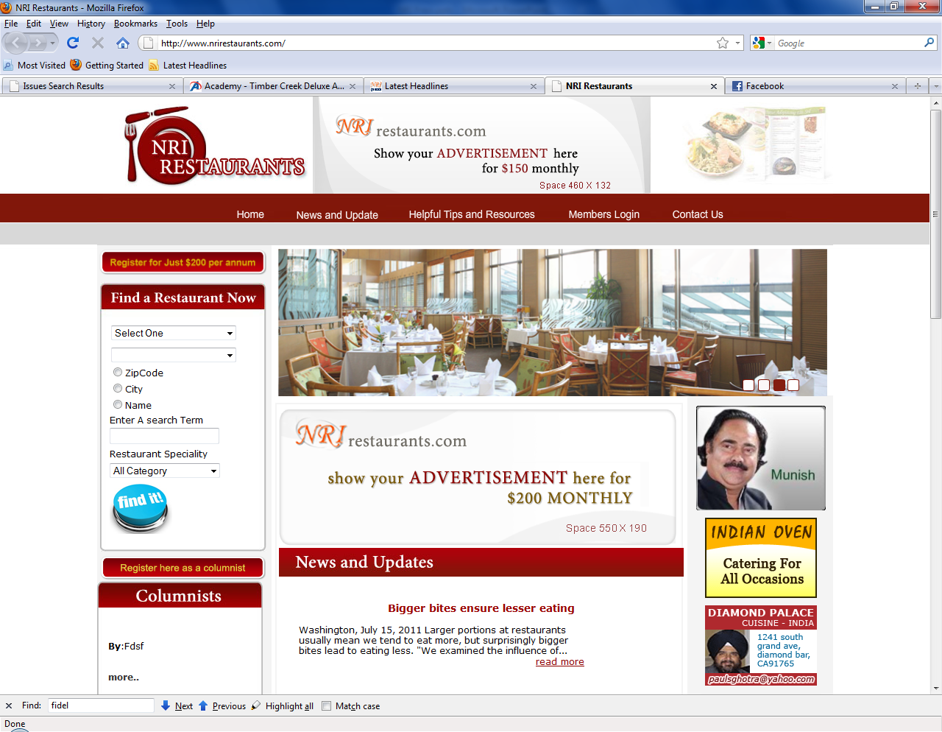
Revenue from one website – NRIRestaurant.com
Adv. Box #1 - $200/Year (own webpage)
Adv. Box #3 - $150/month
Adv. Box #2 - $200/month
Adv. Box #4 – 20 boxes * $100 each box
Adv#1 Membership $200/year (50 restaurants each zone * 4 Zones)
= 200 Restaurants * $200 / year $40,000
Adv#2 and 3 $350/month ($350*12) $ 4,200
Adv#4 $100/month * 20 Business * 12 months $24,000
Total Revenue of NRIRestaurant.com for one year in USA $68,200

Slide 11
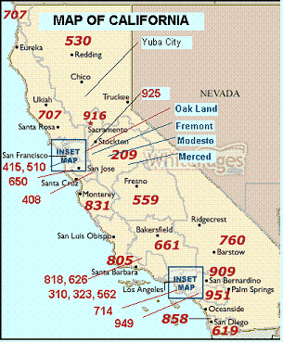
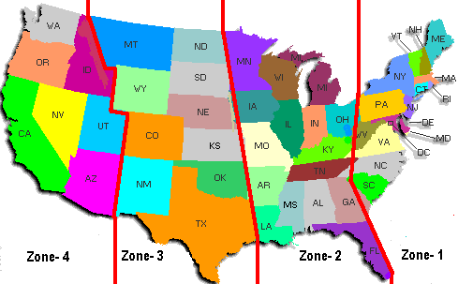
Total Revenues in USA : 30 websites like NRIRestaurant.com, NRIInternet.com and NRIPress.com
Revenue from 20 Websites ($68,000 *20) $ 1,360,000
Revenue from NRIPress.com
From Home Page / Top Box Advertisement ($500 * 12 months) $ 6,000
From Home Page / Right Hand Column ($250 * 20 boxes * 12 months) $ 60,000
Revenue from NRIInternet.com
From Home Page / Top Box Advertisement ($500 * 12 months) $ 6,000
From Home Page / Right Hand Column ($250 * 12 months) $ 60,000
Revenue from Advertisement on Video Project $ ???
Revenue from Advertisement on Home Page and their extension news pages $ ???
Total Revenue of Advertisements for one year in USA $ 1,492,000

Slide 12
Total Revenue
Revenue worldwide from Advertisements
USA: Total Estimated Revenue per year ($ 2625000 x 12) $ 31,500,000
India: Total Estimated Revenue per year $ ??? (can be added+20%)
Canada: Total Estimated Revenue per year $ ??? (can be added+20%)
Europe (U.K., Germany etc.): Total Estimated Revenue per year $ ??? (can be added+20%)
Asia (Singapore, Malaysia etc.): Total Estimated Revenue per year $ ??? (can be added+20%)
Middle East & Africa: Total Estimated Revenue per year $ ??? (can be added+20%)
Revenue from Advertisement on Video Project (depends on no. of video projects) $ ???
Revenue from selling rights for each country/state
(minimum ¼ million for one state like California or BC/ONT) $ ???
Estimated Total Revenue $ ???
Note: Above information is very simple to understand. Our staff is working to prepare revenue in details and with graphs. If any questions/inquries, please feel free to email Karen at karen@nriinternet.com

Slide 13
Company’s Shares Distribution
As per 2009 amendment, we are able to issue 50,000,000 common shares worldwide, such as:
US Accredited Investors
Non-US Subscribers
Above shares distribution by categories ($1.00/share)
As of Dec 31, 2008, all 20 shareholders as listed, have agreed to get their
shares on the basis of their investment, services and founders/issues
(Subject to approval of their services) $30,000,000
2009 plan of options to purchase up to 10 million shares of common stock $10,000,000
Stock option granted to consultants up to 10 million shares of common stock $10,000,000
Total Shares $50,000,000
2009 Plan of options to purchase and 2009 Stock Incentive plan (20 million shares) shall be available as follows:
 | USA | CANADA | UK | MIDDLE EAST & AFRICA | ASIA | INDIA | TOTAL
OPTION TO PYRCHASE | 2 M | 2 M | 2 M | 2 M | 2 M | 2 M | 10 M
STOCK OPTION GRANTED | 2 M | 2 M | 2 M | 2 M | 2 M | 2 M | 10 M
 | 4 M | 4 M | 4 M | 4 M | 4 M | 4 M | 20 M

Slide 14
Company’s Shares Distribution (Cont.)
2009 Plan of options to purchase and 2009 Stock Incentive plan (20 million shares) will be
divided as follows in 4 zones:
 | ZONE 1 | ZONE 2 | ZONE 3 | ZONE 4 | TOTAL
OPTION TO PYRCHASE | 2 M | 2 M | 2 M | 2 M | 10 M
STOCK OPTION GRANTED | 2 M | 2 M | 2 M | 2 M | 10 M

Slide 15
Operations
Jan – June 2009
NRIPress.com started an independent operation.
Globex Tech Inc. as a share holder company, started to work as a management company to set up the whole operation worldwide until any further notice by Board of Directors.
NRIPress.com Inc.’s bank account had been established.
July 2009 – July 2010
We got a great success worldwide by adding entrepreneurs / columnists and advisors in our network.
Our IT Web site development of all our websites started in India, which unfortunately was not executed as planned.
Aug 2010 – Dec 2010
New contract was provided for IT,
NRIPress.com website was established with a new look.
22 Websites were developed in time and had been linked before end of 2010.
More than 100 news added everyday.
More people were trained worldwide to update these web sites.
2. More Entrepreneurs and advisors added.
Jan 2011 – Ongoing efforts
Marketing started to generated revenue.
Worldwide Expansion – Opportunities added.

Slide 16
Opportunities
Since 2000, We have injected capital and quality professional time totaling over 1.5 million dollars our business.
Opportunities For Entrepreneurs:
1) Exclusive Rights to Run Your Own News Media Web site in your City/State/Country:
We are in the process of seeking entrepreneurs/or companies to run media organization in City/State/Country by obtaining rights (just like franchise).
For example: NRIpress.com/CANADA; NRIpress.com/Toronto; NRIpress.com/USA; NRIpress.com/NewYork; NRIpress.com/UK; NRIpress.com/Mumbai; NRIpress.com/India; NRIpress.com/London/ NRIpress.com/Chandigarh…….so on (More to see in application)
WHY SHOULD YOU JOIN OUR NETWORK?
You will run NRI news media in your City/State/Country…..( supported by our news room)
You will share revenue from all advertisements
You will encourage talented columnists/contributors within your jurisdiction to have their article on NRIpress.com
You will promote business investment from NRIs in your jurisdiction.
You will run NRI business association in your City/State/Country through membership/seminars ( our association will support)

Slide 17
Opportunities
Opportunities For Entrepreneurs:
1) Exclusive Rights to Run Your Own News Media Web site in your City/State/Country (Continue…):
Proposal 1 : Exclusive rights on the basis of City or State or Country
Revenue shares:
35% go to Exclusive rights owners.
35% go to management companies: IT- web site development, continuous maintenance of web sites, news manage and updating.
30% go to NRIpress.com, Inc.

Slide 18
Opportunities For Entrepreneurs (Continue ….) Proposal 1 : Exclusive rights on the basis of City or State or Country
Site Scope | Exclusive rights for | Cost | At time of signing the contract | Balance to be Collected Through | Signing Bonus Offered | Incentive Shares for Consultant
State Sites | Canada: 1. NRIPress.com/BC (or Ont): $50,000 2. Any other state or Major City: $25,000 India: 1. NRIPress.com/Punjab (or Guj): $50,000 2. NRIPress.com/all other states (or Major city): $25,000 USA UK: | Value as Shown in left column | 20% Down Payment | 4 installments within a year | After signing the agreement, next six months revenue can be converted to your future installment or pay the difference ( except city rights have already been sold) | You can sell rights up to four cities to recover your buying full cost. If we agree to sell rights to more cities, you will be paid 25% of total value. You can earned incentive shares equal your investment or more shares with your services to the company
Premium Country Sites | 1, NRIPress.com/Canada 2.NRIPress.com/India 3.NRIpress.com/UK 4.NRIPress.com/US | $200K | 20% Down Payment | 4 installments within a year | After signing the agreement, next six months revenue can be converted to your future installment or pay the difference ( except city/State rights have already been sold) You can sell rights to States/ cities to recover your investment ($200,000 or partial payment). If we agree to sell rights to more States , you will be paid 25% of total value. | You can earned incentive shares equal your investment or more shares with your services to the company.

Slide 19
Opportunities For Entrepreneurs (Continue ….) Proposal 1 : Exclusive rights on the basis of City or State or Country
Site Scope | Exclusive rights for | Cost | At time of signing the contract | Balance to be Collected Through | Signing Bonus Offered | Incentive Shares for Consultant
Platinum Country Sites | 5. NRIPress.com/Australia 6.France 7.Hong Kong 8. Indonesia 9.Italy 10.Malaysia 11.New Zealand 12.Soudi Arabia 13. Singapore 14. South Africa | $25K | $10K | 4 installments within a year | Same as Above (Point 1) You can sell rights up to four cities to recover your buying full cost. If we agree to sell rights to more cities, you will be paid 25% of total value. | Same as Above
Other Country Sites | NRIPress.com/all other countries | $10K | $10K |  | Same As Above (Point2) | Same as Above

Slide 20
Opportunities For Entrepreneurs: 1) Exclusive Rights to Run Your Own News Media Web site in your City/State/Country (Continue…):
Proposal 2 : 30 web sites- Mega Project: (Ex: NRIrealtors.com, NRIdoctors.com, NRIdentists.com, so on. ..
Exclusive rights for each web site in one State or one Country
Example | Rent | At time of signing the Contract | Revenue
NRIAccountants.com NRIastrology.com NRIbanks.net NRIbanquethalls.com NRIcars.com NRIdentists.com NRIdoctors.com NRIfashions.com NRIfarmers.com NRIgrocery.com NRIhospitals.com NRIhotels.com NRIimmigration.com NRIinsurance.net NRIjewellers.com NRIlawyers.com NRImortgage.com NRIrealtors.com NRIrestaurants.com NRItravelagencies.com NRItrucks.com NRIvideo.com | Any Website for one State (See below rates)
 | $500 per month | $2,000.00 | Revenue will be split 50:50 after $500 collection
 | Any Website for one Country (See below rates)
 | $2000 per month | $5,000 | Revenue will be split 50:50 after $2000 collection

Slide 21
Opportunities
Opportunities For Entrepreneurs (continue…):
2) Sales, Advertising and Marketing
To help our local Exclusive Right owners, we need individuals or companies who, as partners, can:
Sell rights for City/State/Country.
Generate revenue worldwide.
Expand media network in each city.
3) News Area Expansion:
To help our local Exclusive Right owners:
We are looking at least one news paper/ or news website specialist owner who can be a part of our network for mutual benefits.
All News and press release will be controlled by our central News office
4) Entertainment Companies:
Bollywood is the biggest film industry in the world, producing 800-1000 films a year. NRIs/PIOs like to learn more about Bollywood films through Web site reviews (73.7%).
We are looking for companies or entertainment web site owners who have a knowledge of bollywood industry worldwide. For mutual benefits, you can be a partner of our entertaiment division.

Slide 22
Opportunities
Opportunities For Entrepreneurs (continue…):
5) Columnists/ Contributors:
NRIpress.com is expanding in various areas such as bloggers, comments and other community services to it's readers. We are looking columnists and contributors in all the fields they feel comfortable.
6) Job and Placement :
We have entity which is involved in the NRI job placement services for the past 17 years. You might aware that international companies in India as well as in other countries need skilled professionals. We are looking existing placement companies in India which can be a part of our expansion
7) NRIpress Seminars:
Why we need Seminars:?
We should have NRI Seminars at least once a year in each major city of India and as well as other countries where nri population is concentrated because it will:
a) Help us to establish our strong NRI Network.
b) Encourage NRIs to become members of NRI Network
c) Help to local city/State rights owners to get more revenue and & expansion in all fields.
d) Promote NRI Business owners to get mutual benefits.
e) Encourage 2nd young generation to involve in seminars
f) Allow us to invite politician’ bureaucrats / entrepreneurs/ scholars... as speakers. Also invite entertainers/ actors/ actresses
g) Allow us to set up "Award Ceremony" in recognition of scientist-technologist, entrepreneur, inventor, educator and men and women of the year.

Slide 23
Opportunities
Opportunities For Entrepreneurs (continue…):
8) Establishment of NRI Associations:
Now NRIs worldwide need/ or should have its own one voice to be heard because:
Discrimination worldwide at jobs/ private sector/political/govt./ and judicial system
In India: Their properties grabbed/ need to protect their rights/ visa travel problems.
(A) To accomplish this we need to establish:
1. NRI Network in each city/state/country
2. Seminar at least once a year in the major city/state/country , where NRI population is concentrated
3. Hot Line to help NRIs by 24/7: Worldwide and also in India
4. News Letter: monthly or weekly by email to all NRIs worldwide: nri problems, events, current issues ...
5.To help 2nd generation:- in job placement, education, financial support and encourage them to involve in- politics, Media and business seminars.
( B ) Also more benefits to members and business owners.
1. Insurance discount package- for cars, home and family
2. Special discounts to buy cars/ airline tickets/ Indian shows
3. Share accommodation in major cities.
4. Mutual benefits to business owners:
We will encourage to NRI members and readers:
To buy product from our own people such as: cars, groceries, jewelry….
Get services from our doctors/dentists, insurance, Real estate, Mortgage….. see all web sites left column on NRIpress.com
Note: Your voice will be heard worldwide in seconds through nripress.com.

Slide 24
Advertisement (Reach NRIs through NRIPress)
Why advertisement with NRIPress?
Benefits unlimited:
NRIPress’s Websites are one of the most effective and inexpensive ways to promote your products and services to NRIs worldwide
Business can reach millions of NRI readers in NRI community local and worldwide. Our readers are increasing 20-25% every year.
You can target customers in our NRI community:
We will customize your e-mail addresses.
Build a NRI Global Network of Success
Develop valuable contacts all over the world. As a partner with our NRI global marketing team, you will associate with NRI professionals, and businesses.
Ex: NRIPress has 30 web sites (www.NRIaccountants.com, NRIrealtors.com....so on) and 4 member sponsored each web site= 140 members in big cities like New York or Toronto. These members or associates will give business each other or refer each other.
News Papers Advertisement cost can be reduced up to 70%.
Ex: Through NRIRealtors.com, all associate realtors can be networked and get one advertisement for all agents in low cost.

Slide 25
Advertisement (Reach NRI through NRIPress)
Why advertisement with NRIPress (Continue…):
Website Promotion:
NRIPress can help you make of your Web Site as a link from NRIPress’ websites, which will get you more business opportunities.
A Family Business with Tax and Inheritance Benefits.
Your family can work with you . Allowing you tax deductions on help from your children and plus deductions for travel, publications, seminars, gas, phone, electricity bills, etc. Save money.
Tap the Exploding NRI Global Market of the Internet.
The Internet is global Worldwide and exploding. USA TODAY recently reported that over 170,000 new people are getting online every 24 hours. Many smart business people are becoming millionaires on the Internet. And this is just the beginning!
The Lowest Cost Way to Earn Income Online.
Thanks to the Internet, your business expenses are minimal. You can contact millions on the Internet via e-mail, search engines, directories, free ads, etc.

Slide 26
Our Advisors
Worldwide Advisors List (Most of whom are shareholders)
1. Mr. Uka Solanki, Engineer, and a very Successful Entrepreneur, owns 17 stores with revenue of approximately 100 Million per year.
2. Mr. Inder Singh, Gopio Chairman, Founder of many organizations, and very well connected worldwide through community services.
3. Mr. Harbhajan Samra, MS in Economics, Entrepreneur, running big farms and is commonly known as “OKRA KING”.
4. Dr. Sukhminder Singh, PhD in Civil Engineering, well known Professor and involved in community Services.
5. Mr. A. Monga, King of Perfume Business, with annual revenue of approximately 50 Million in the US. He also runs charity events in India (100 Crores). He is also very well connected with Politics and News Media.
6. Mrs. B. Toor, MA, Columnist/Entrepreneur.
7.Bhullar Brothers: Entrepreneurs
8. Mr. Mukherjee, IPS (ret), Calcutta, Our Founder’s good friend and runs Charities. His son is a Top Scientist, IT and Servers in USA.
9. Mr. N. Rattan, IAS (ret.) Punjab, India, past 35 years of acquaintance.
10. Mr. S. Agarwal, IT Administrator for WORLDWIDE operations.
11. Tanu Singh, IT professional, India, (with staff of 15 people).

Slide 27
Our Advisors
Worldwide Legal Advisor
1. SHIV GREWAL: LLM, senior corporate partner with the law firm of Stradling Yocca Carlson & Rauth, which has over 100 lawyers. Specializes in Corporate and Security Laws; including general Corporate representation, venture capital financing, initial public offerings, corporate reorganizations & Joint Ventures, Co-founder, HealthScribe, Inc. and FirstRing, Inc.
2. Mr. G. Suman: Appointed as a Company Lawyer in India. Mr. Suman belongs to a family hailing in Judicial System. His father is a retired Judge, and his brother is also currently a Judge in India.
3. Dr. S. Mukherjee (IPS retired) PhD, will coordinate with, and support Mr. Suman

Slide 28
Questions ?

Slide 29
THANKS FOR YOUR TIME

